Slide 1


Slide 2

Using Controlled Vocabularies to Manage Resource Relationships:
The KMODDL Experience
Martin Kurth, Greg Nehler, Rick Silterra
Cornell University Library Metadata Services
DC-2005 Madrid, 15 Sept 2005

Slide 3

Overview
KMODDL Domain
KMODDL Type Vocabulary
Models of Bibliographic Relationships
Voigt Identifiers and Subjects
KMODDL Application Profile
Demo and Questions

Slide 4
KMODDL Domain
KMODDL is the Kinematic Models for Design Digital Library, an NSDL and IMLS project
Kinematics is the "geometry of pure motion"
The core KMODDL collection is Cornell's Reuleaux Collection of Mechanisms and Machines

Slide 5
KMODDL Domain
Reuleaux Collection resource categories
still and interactive images of kinematic models
computer simulations
stereolithography files for "printing" replicas
classroom tutorials
historical and theoretical texts
biographical sketches

Slide 6
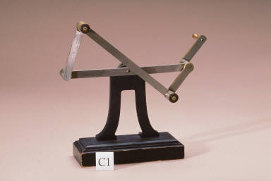
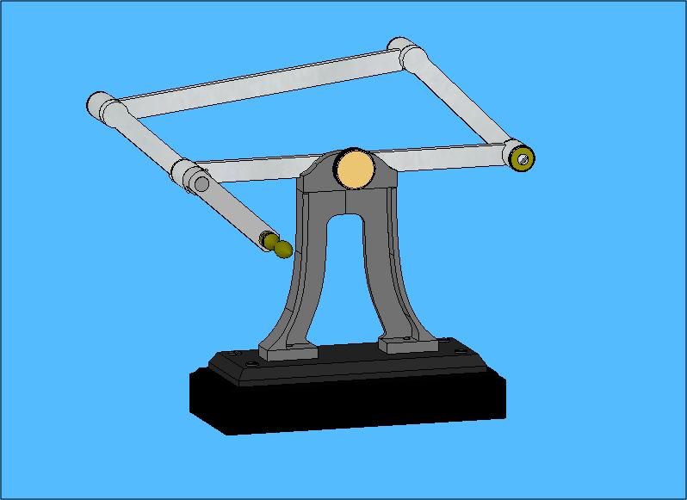

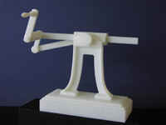
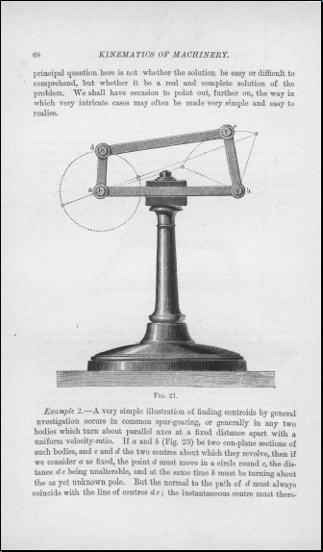
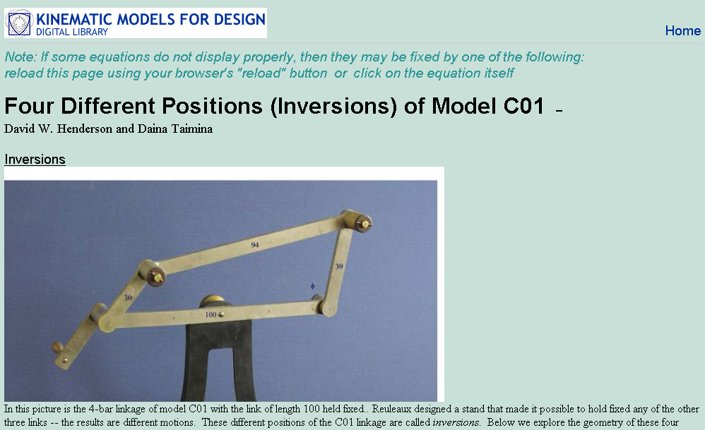
KMODDL Domain
Reuleaux Collection resource categories

Slide 7
KMODDL Domain
Voigt/Reuleaux Classification of Mechanisms
Devised for the Voigt Mechanische Werkstatt catalog of 300+ Reuleaux mechanisms
Alphanumeric scheme
25 classes
Each class divided into 2 to 39 subclasses

Slide 8
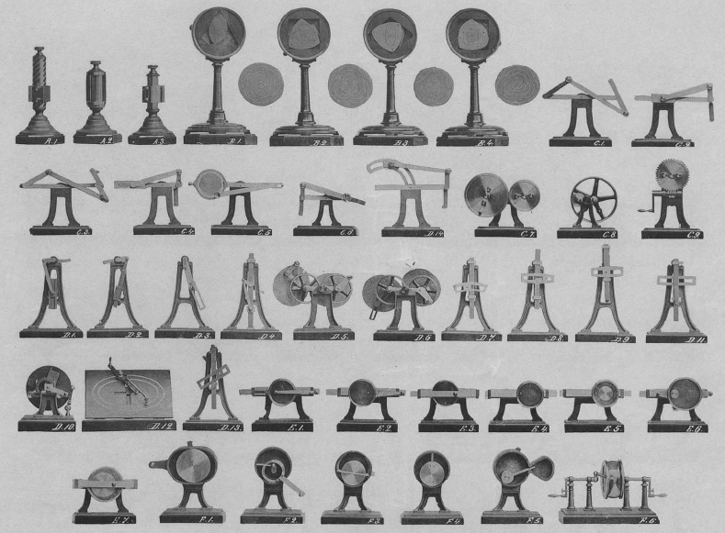
Kinematische Modelle nach Prof Reuleaux, 1907

Slide 9
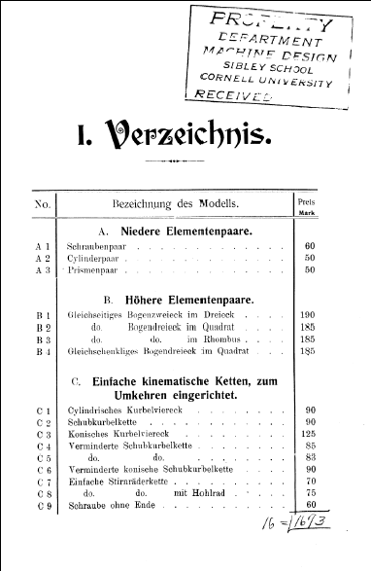
Kinematische Modelle nach Prof Reuleaux, 1907

Slide 10
KMODDL Domain
Voigt/Reuleaux Classification of Mechanisms
Devised for the Voigt Mechanische Werkstatt catalog of 300+ Reuleaux mechanisms
Alphanumeric scheme
25 classes
Each class divided into 2 to 39 subclasses

Slide 11
KMODDL Type Vocabulary
Article_Digital | BookSection_Digital | Movie | StillImage
Article_Print | BookSection_Print | Paper_Digital | ThesisDissertation_Digital
Biography | ConferenceProceeding_Digital | Paper_Print | ThesisDissertation_Print
Book_Digital | ConferenceProceeding_Print | Simulation | Tutorial
Book_Print | Model | StereolithographyFile | VRM

Slide 12
KMODDL Types: Versions
Article_Digital | BookSection_Digital | Movie | StillImage
Article_Print | BookSection_Print | Paper_Digital | ThesisDissertation_Digital
Biography | ConferenceProceeding_Digital | Paper_Print | ThesisDissertation_Print
Book_Digital | ConferenceProceeding_Print | Simulation | Tutorial
Book_Print | Model | StereolithographyFile | VRM

Slide 13
KMODDL Types: References
Article_Digital | BookSection_Digital | Movie | StillImage
Article_Print | BookSection_Print | Paper_Digital | ThesisDissertation_Digital
Biography | ConferenceProceeding_Digital | Paper_Print | ThesisDissertation_Print
Book_Digital | ConferenceProceeding_Print | Simulation | Tutorial
Book_Print | Model | StereolithographyFile | VRM

Slide 14
Models of Bibliographic Relationships
Tillett’s taxonomy
Equivalence
Derivative
Descriptive
Whole-part
Accompanying
Sequential
Shared characteristic

Slide 15
Models of Bibliographic Relationships
Functional Requirements for Bibliographic Records
Work - intellectual/artistic creation
Expression - realization of a work
Manifestation - physical embodiment of an expression of a work
Item - instance of a manifestation

Slide 16
Models of Bibliographic Relationships
Functional Requirements for Bibliographic Records
Manifestation
embodies
Expression
realizes
Work
Voigt model
embodies
Reuleaux design
realizes
V/R subclass

Slide 17
Models of Bibliographic Relationships
FRBR/Tillett’s taxonomy
Work
supplements
Work
describes
Article, etc.
supplements
V/R subclass
describes

Slide 18
Models of Bibliographic Relationships
KMODDL application profile
Movie
Book_Digital
isVersionOf
references
C06

Slide 19
KMODDL Application Profile
Encoding schemes
Voigt1-ID - Voigt/Reuleaux alphanumerics
Voigt1 - Voigt/Reuleaux class & subclass terms
KMODDLType

Slide 20
KMODDL Application Profile
Encoding schemes & FRBR basic functions
Voigt1-ID - Voigt/Reuleaux alphanumerics
Voigt1 - Voigt/Reuleaux class & subclass terms
“find all manifestations of a work”
KMODDLType
“identify & select manifestations by form or type”

Slide 21
KMODDL Record for a Movie of C06
<kmoddl_dc:kmoddl>
<dc:title>Slider Crank Mechanism</dc:title>
<dc:contributor>Loeffler, Kent</dc:contributor>
<dc:publisher>Cornell University</dc:publisher>
<dc:description>In this model, the link with the sliding pin is fixed. If this were an engine slider crank, the cylinder would oscillate as the piston moved up and down. See also discussion about model C02.</dc:description>
<dc:type xsi:type="dct:DCMIType">MovingImage</dc:type>
<dc:type xsi:type="kmoddl_dc:KMODDLType">Movie</dc:type>
<dc:format xsi:type="dct:IMT">video/quicktime</dc:format>
<dct:extent>193 Kb</dct:extent>
<dct:extent>320 x 212 pixels</dct:extent>
<dc:identifier xsi:type="dct:URI"> http://kmoddl.library.cornell.edu/resources.php?id=176</dc:identifier>
<dct:isVersionOf xsi:type="dct:URI"> http://kmoddl.library.cornell.edu/model.php?m=13</dct:isVersionOf>
<dct:isVersionOf xsi:type="kmoddl_dc:Voigt1-ID">C06</dct:isVersionOf>
<dct:educationLevel xsi:type="dlese:DLESEgradeRangeType">General public </dct:educationLevel>
<dc:rights>For educational use only. All rights reserved by the contributor(s) and publisher(s).</dc:rights>
</kmoddl_dc:kmoddl>

Slide 22
KMODDL Record for a Digital Book Citing C06 & S34
<kmoddl_dc:kmoddl>
<dc:title>History of the Growth of the Steam-Engine</dc:title>
<dc:creator>Thurston, Robert Henry</dc:creator>
<dc:publisher>D. Appleton</dc:publisher>
<dc:subject xsi:type="kmoddl_dc:Voigt1">Slider Crank Mechanism</dc:subject>
<dc:subject xsi:type="kmoddl_dc:Voigt1">Cartwright Straight-line Mechanism</dc:subject>
<dc:type xsi:type="dct:DCMIType">Text</dc:type>
<dc:type xsi:type="kmoddl_dc:KMODDLType">Book_Digital</dc:type>
<dc:identifier xsi:type="dct:URI"> http://kmoddl.library.cornell.edu/bib.php?m=2</dc:identifier>
<dct:references xsi:type="dct:URI"> http://kmoddl.library.cornell.edu/model.php?m=13</dct:references>
<dct:references xsi:type="dct:URI"> http://kmoddl.library.cornell.edu/model.php?m=243</dct:references>
<dct:references xsi:type="kmoddl_dc:Voigt1-ID">C06</dct:references>
<dct:references xsi:type="kmoddl_dc:Voigt1-ID">S34</dct:references>
<dct:educationLevel xsi:type="dlese:DLESEgradeRangeType">General public</dct:educationLevel>
<dc:rights>For educational use only. All rights reserved by the contributor(s) and publisher(s).</dc:rights>
</kmoddl_dc:kmoddl>

Slide 23
Demo and Questions

